Slide 1
Spinnaker Installation
By OpxMx

Slide 2

Prerequisite
Oracle Virtualbox - (https://www.virtualbox.org/wiki/Downloads)
Vagrant - (https://www.vagrantup.com/downloads.html)
Git - (https://git-scm.com/downloads)
Min - 8GB Ram
Min - 2 or more CPU
Min - 40GB Disk

Slide 3
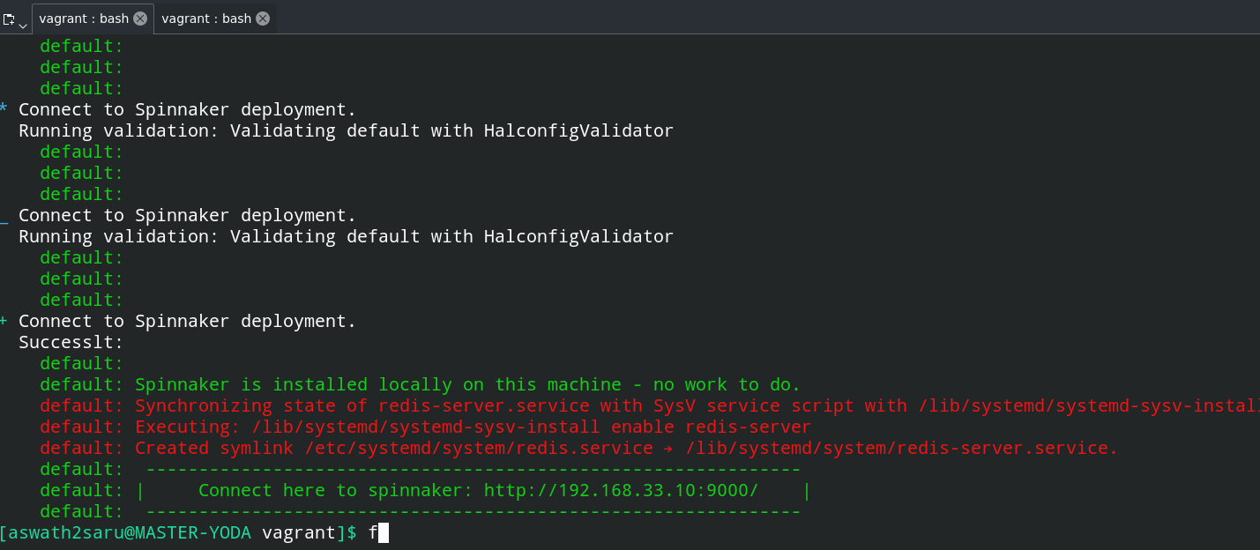
Steps
Git clone :
# git clone https://github.com/OpsMx/OpsMx-Spinnaker-Tutorial.git
# cd OpsMx-Spinnaker-Tutorial/vagrant/
Vagrant start:
# vagrant up (It take times to build and install Spinnaker ~25 min - Depends on the internet speed)
Connect the spinnaker machine:
# vagrant ssh

Slide 4
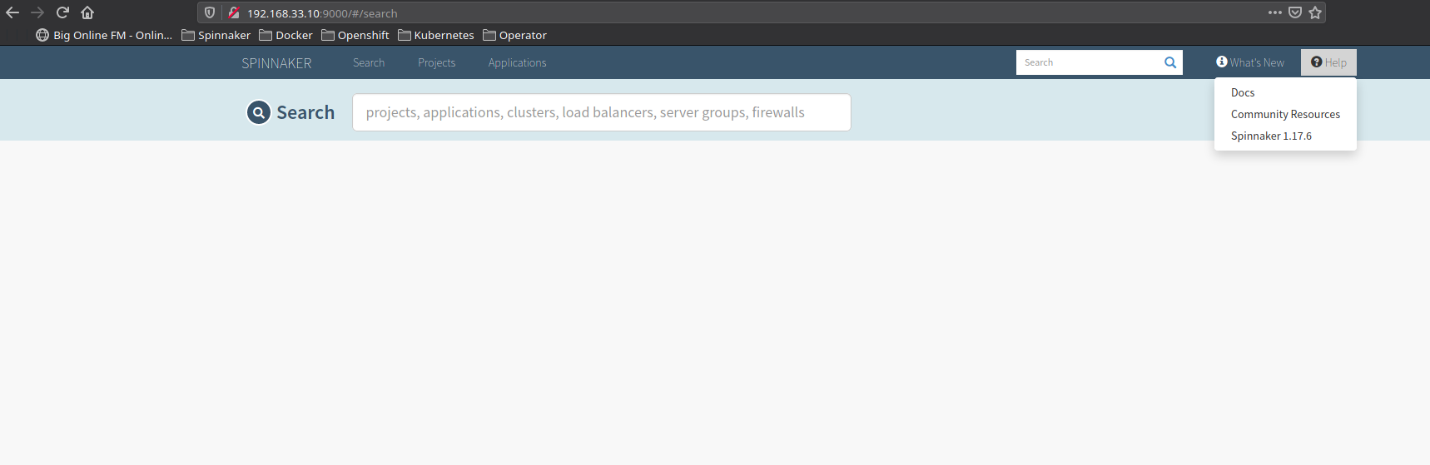
How To Connect ?

Slide 5
Thank You :)

